Slide 1

Stage 5 Compressed Unimaginable Neutralized Threat Course Designer: Jay Slater
Compressed Unimaginable Neutralized Threat is a 17 round, 85 point Comstock Medium course. There are 8 IPSC targets and 1 steel targets. The best two hits per target will score. Steel must fall to score. The start signal is audible.
The Handgun start position is standing anywhere with wrists below belt. Handgun loaded and holstered. The PCC start position is standing anywhere, PCC loaded, stock on belt, safety on.
On the audible start signal, engage all targets from within the shooting area. Popper activates swinger which does not remain visible at rest.

Slide 2
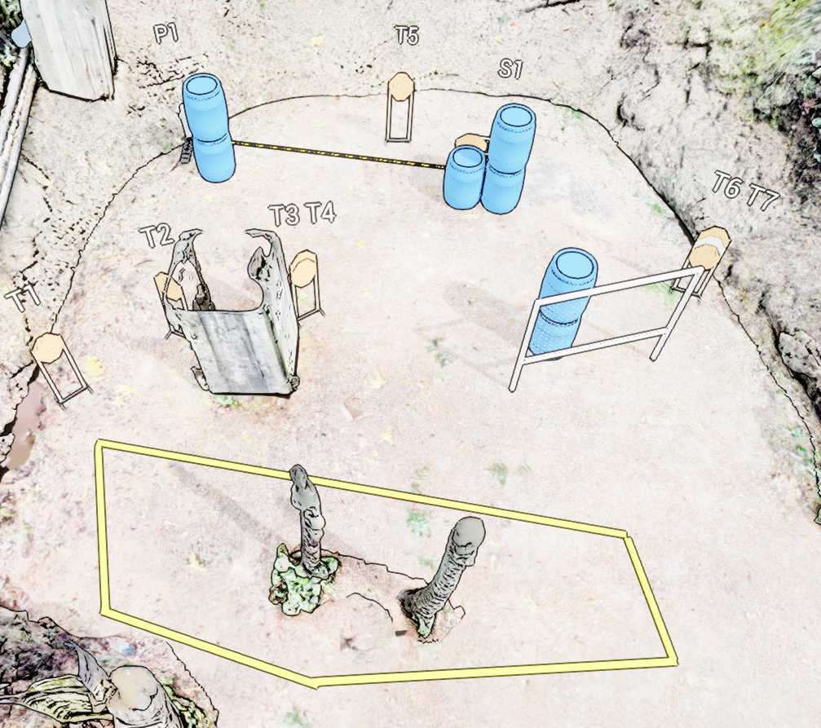
 | Stage 5 Compressed Unimaginable Neutralized Threat Course Designer: Jay Slater

